Slide 1
Taylor Swift
By Ulani Krumpak

Slide 2

Early Life
She was born on the 13th December 1989 in reading America

Slide 3
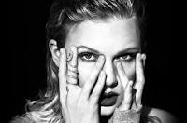
FAMOUS LIFE
SHE WAS INSPIRED BY SHANIA TWAIN

Slide 4

.
FAMOUS SONG

